Slide 1

PROJECT ON
Web Scraping and Exploratory Data Analysis of Online Book Data
Presented by
- Thota Ramya

Slide 2
ABOUT ME
Name : Thota Ramya
Batch no : 386
LinkedIn : www.linkedin.com/in/thotaramya106
Git Hub : https://github.com/
Email : thotaramya106@gmail.com

Slide 3
CONTENTS
Project Introduction
Problem Statement
Dataset Overview
Methodology
Data Preprocessing
Exploraratory Data Analysis

Slide 4
PROJECT INTRODUCTION
The "Books to Scrape Project" is a data-driven initiative designed to extract, process, and analyze book-related information from the fictional online bookstore at https://books.toscrape.com.
The project aims to demonstrate a complete data workflow, starting with web scraping to collect book details such as titles, prices, ratings, and categories, followed by data preprocessing and cleaning to ensure quality.
Subsequent steps include exploratory data analysis (EDA) to uncover trends and patterns, data visualization to present findings effectively, and finally, deriving insights and conclusions to inform potential business or research applications.
Leveraging Python tools like Requests, BeautifulSoup, and pandas, this project serves as a practical example of web scraping and data analysis, adaptable for educational purposes or as a foundation for real-world e-commerce data projects

Slide 5
PROBLEM STATEMENT
In today’s digital era, online book marketplaces provide a wide range of information such as titles, prices, availability, ratings, genres, and descriptions. However, this data is often presented in an unstructured format on websites, making it difficult for researchers, businesses, and readers to analyze trends and make informed decisions.
This project aims to develop a web scraping solution that extracts structured book-related data from Books to Scrape (books.toscrape.com). The collected dataset is then used for Exploratory Data Analysis (EDA) to uncover insights such as price distribution, availability patterns, popular genres, and rating trends.
By automating data collection and analysis, the project addresses the challenge of transforming unstructured online information into valuable insights, enabling better decision-making for publishers, retailers, and readers.

Slide 6
DATASET OVERVIEW
The dataset is collected from Books to Scrape (books.toscrape.com) using web scraping techniques.
It contains 1000 books across 50 pages.
Each book entry includes both categorical and numerical features.
Information covers aspects like title, price, availability, rating, description, and genre.
Key Features
Title – Name of the book
Price – Price of the book in GBP (£)
Rating – Customer rating (One to Five stars)
Availability – Stock status of the book
Genre – Category of the book
Description – Short description of the book
UPC, Product Type, Tax, Number of Reviews – Extracted from product details page
Book URL – Direct link to the book’s detail page

Slide 7
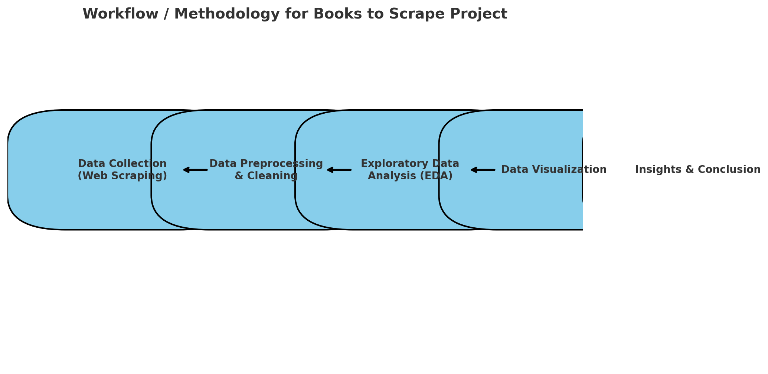
METHODOLOGY

Slide 8
DATA PREPROCESSING
Missing Values
Item Weight: Only 2 missing values observed, which is negligible (0.2% of 1,000 records). Consider imputing with median or mode based on Item Type.
Duplicate Records
Observation: 2 duplicate rows identified out of 1,000 books (0.2%). These likely result from pagination overlap or repeated page fetches.
Action: Remove duplicates using df.drop_duplicates() to ensure unique entries.
Outliers
Price: Values exceeding 22,270 (e.g., potential typos or currency conversion errors) are extreme outliers compared to the typical range of £10-£60. Use IQR method:
Calculate Q1 and Q3, then set outlier threshold as Q3 + 1.5 * IQR.
Replace or cap outliers with the 99th percentile (~£60).

Slide 9
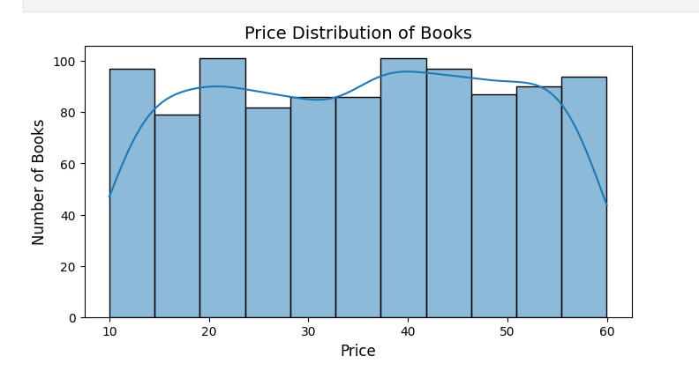
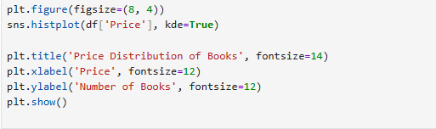
EXPLORATORY DATA ANALYSIS
Price distribution Histogram

Slide 10
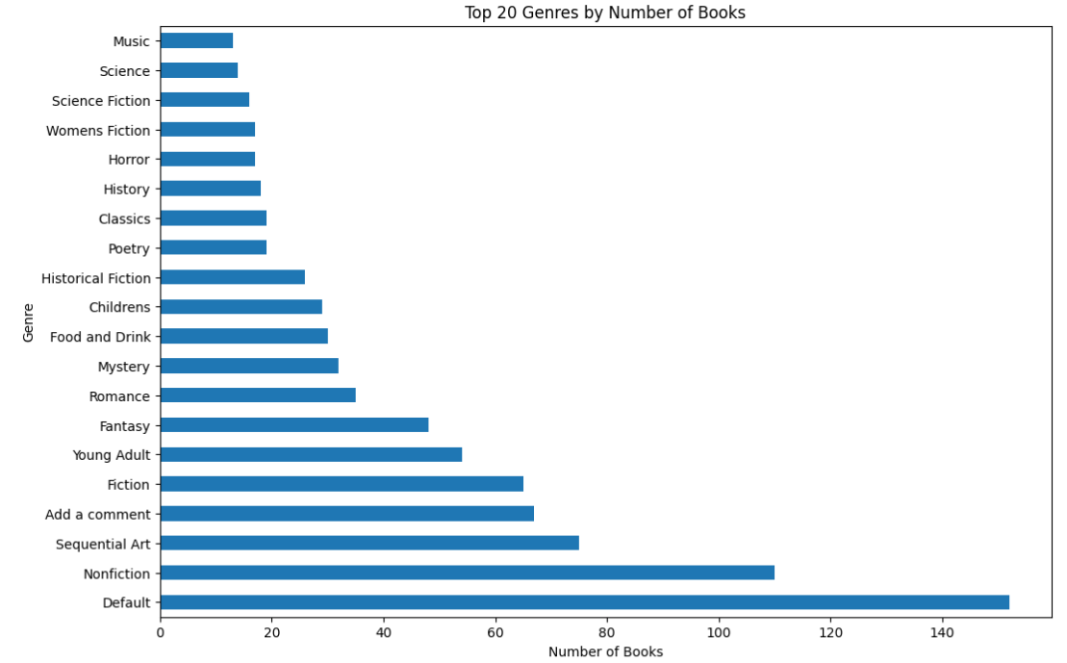
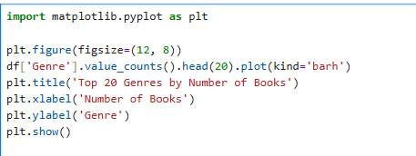
COUNT OF BOOKS PER GENRE

Slide 11
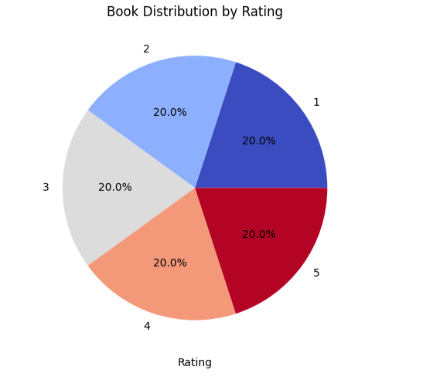
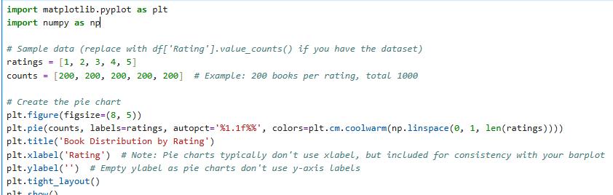
BOOK DISTRIBUTION BY RATING
PIE CHART

Slide 12
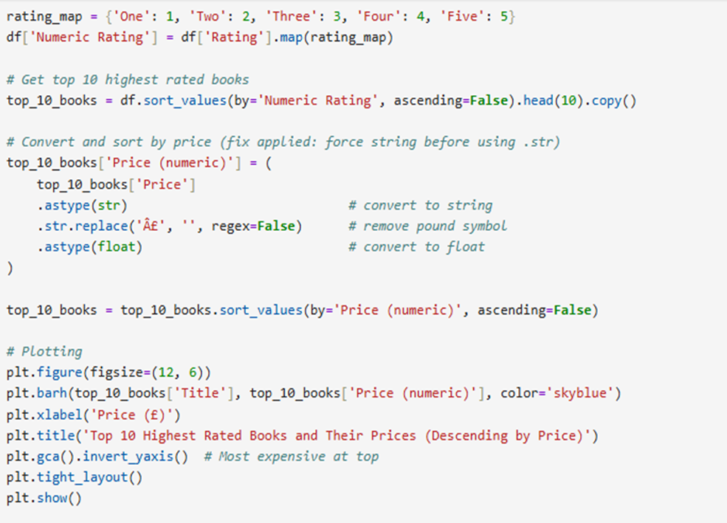
TOP 10 HIGEST-RATED BOOKS

Slide 13
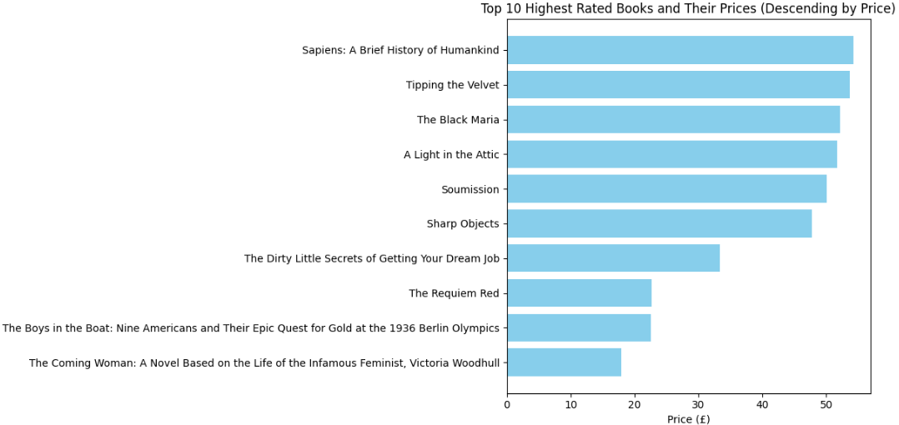
TOP 10 HIGEST-RATED BOOKS

Slide 14
CONCLUSION
The "Books to Scrape Project" shows a complete process of collecting and understanding book data. I scraped 1,000 book details (like titles, prices, and ratings) from https://books.toscrape.com using Python. We cleaned the data by fixing missing parts and duplicates. The analysis found that price doesn’t depend on ratings and that some categories, like "Default" and "Nonfiction," have more books than others. Pie charts and bar plots made these patterns clear, with ratings spread evenly.
This suggests focusing on different categories rather than ratings for pricing. The data is from a fake site, so it’s limited, but it’s good for practicing. Next time, we can add better error checks or use real site data. This project is a great start for learning and can grow into bigger analyses.

Slide 15
THANK YOU

